Slide 1
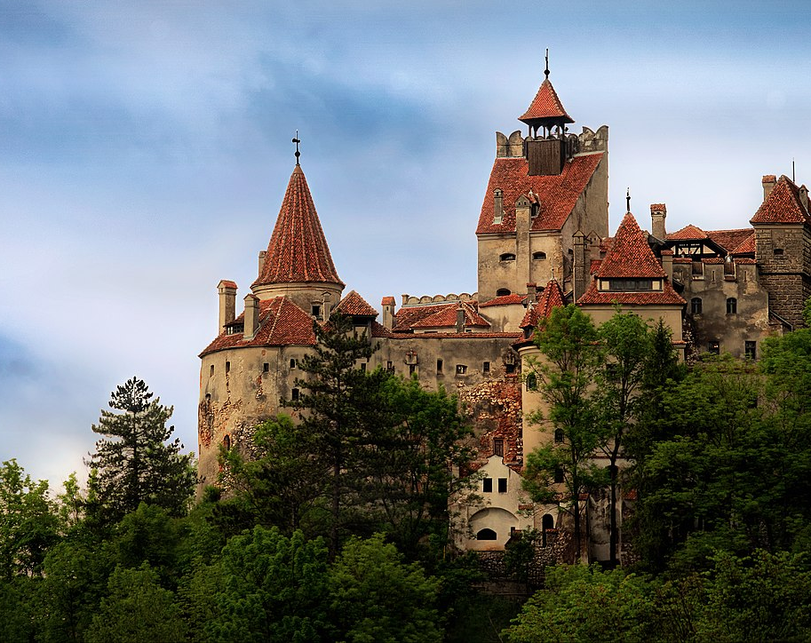
We are going to run to Bran Castle. The setting for the story Dracula.

Slide 2
It is located in Transylvania, Romania. It’s 2,544 Kilometres from Dublin,

Slide 3
First stop is Bram Stoker’s House in Dublin.
He wrote the novel Dracula.
It is just 11 kilometres from our school.

Slide 4
We will run laps of the astro or the yard
For Junior Infants to 3rd Class 1 lap = 1 kilometre.
For 4th Class to Sixth class 3 laps = 1 Kilometre.
We have some spooky stops along the way .

Slide 5
Next is the Edinburgh Vaults.
It is 446 kilometres away.

Slide 6
And our final destination is Bran Castle.
This will be the end of our journey.
We might even see Dracula!

Slide 7
After that, our next stop is Moosham Castle in Austria. Also known as Witches Castle. It is 2,022 kilometres.

Slide 8
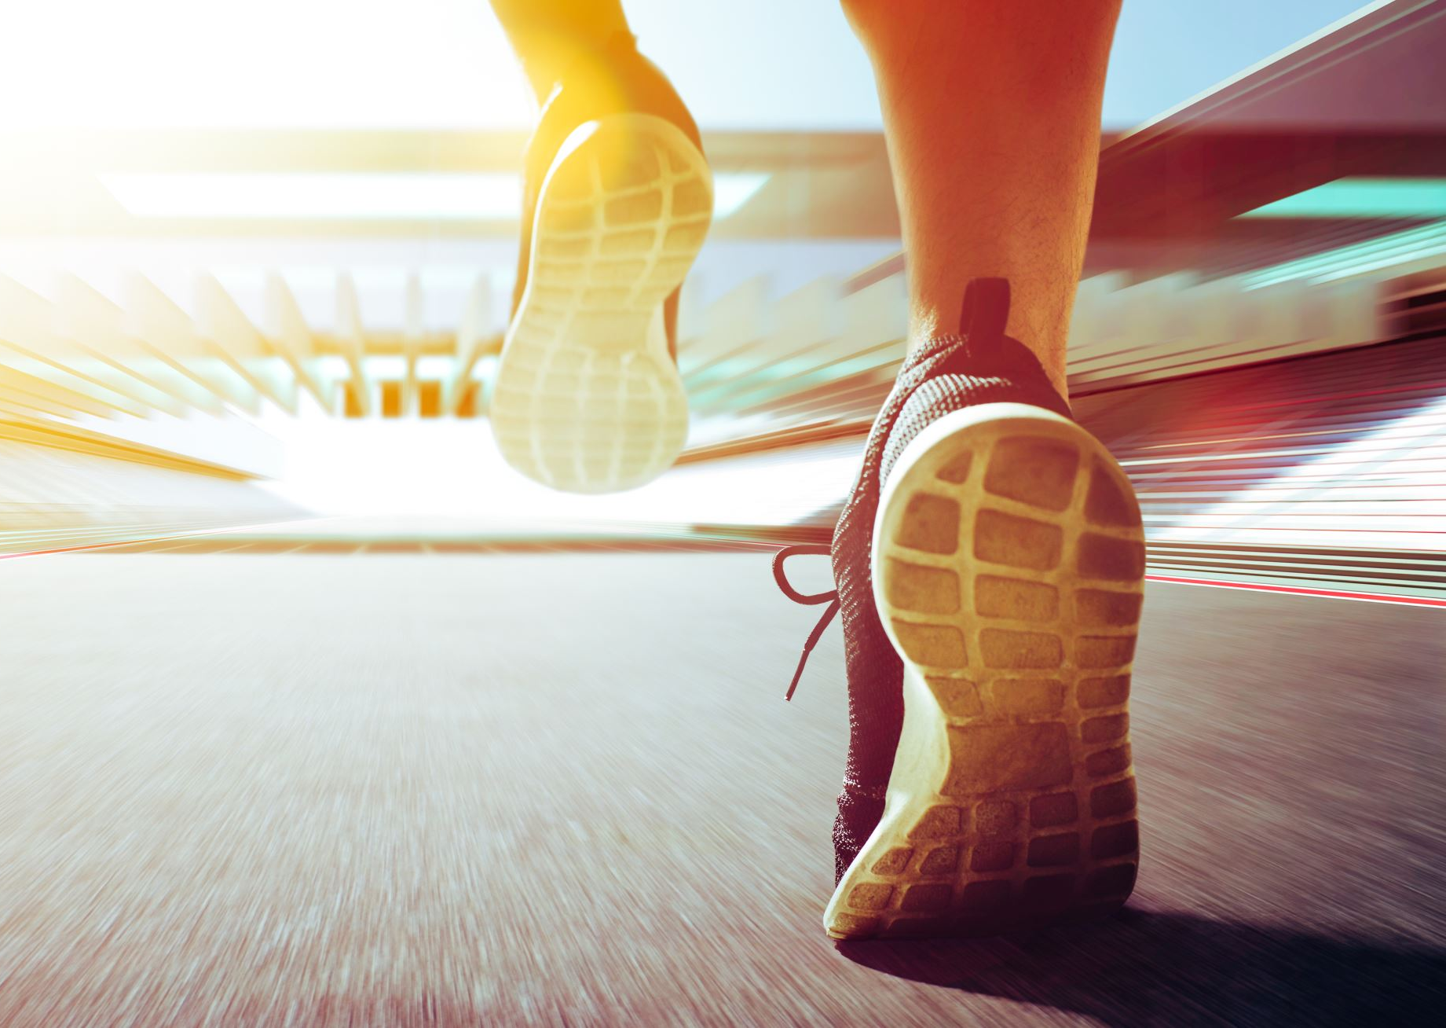
So, remember!
Get out running as often as possible.
Wear your runners to school.
Be active and have fun!

